Slide 1


Slide 2
Objectives
To understand
Definition of Cyber Crime
Classification of Cyber crimes
Computer Intrusions and Hacking
Computer Security

Slide 3
Cyber Crime
Cybercrime also known as Computer crime, refers to any crime that involves a computer/mobile and a network.
The computer may have been used in the commission of a crime, or it may be the target.
Netcrime is criminal exploitation of the internet.
Experts defined Cybercrime as "Offences that are committed against individuals or groups of individuals with a criminal motive to intentionally harm the reputation of the victim or cause physical or mental harm to the victim directly or indirectly, using modern telecommunication networks such as Internet (Chat rooms, emails, notice boards and groups) and mobile phones (SMS/MMS)".
Such crimes may threaten a nation’s security and financial health.

Slide 4

Cyber Crime
A simple yet sturdy definition of cyber crime would be
“unlawful acts wherein the computer is either a tool or a target or both”.

Slide 5
Biggest Cyber Attacks 2017
Equifax Data Breach – 145.5 Million Accounts
Uber Data Breach – 57 Million Records
WannaCry Cyber Attack – 300,000 Systems
Yahoo! Makes History, Again – 3 Billion Accounts
Deep Root Analytics Data Breach – 198 Million U.S. Voters
Rasputin Attacks – 60 Universities and Federal Agencies

Slide 6
Surface Web vs Deep Web vs Dark Web

Slide 7
Surface Web vs Deep Web vs Dark Web
Dark Web vs Deep Web vs Surface Web
Darknet/Dark Web | Restricted to special browsers Not indexed for Search Engines Large scale illegal activity Unmeasurable due to nature
Deep Web | Accessible by password, encryption, or through gateway software Not indexed for Search Engines Little illegal activity outside of Dark Web Huge in size and growing exponentially
Surface Web | Accessible Indexed for Search Engines Little illegal activity Relatively small in size

Slide 8
Cost of Information in Dark Web
Bank credential: $1,000 plus (6% of the total dollar amount in the account)
U.S. credit card with track data (account number, expiration date, name and more): $12
EU, Asia credit card with track data: $28
Hacking into a website: $100 to $300
Counterfeit social security cards: $250 and $400
Counterfeit driver's license: $100 to $150

Slide 9
Classification of Cyber Crimes
Threatening email, assuming someone’s identity, defamation, SPAM and Phishing are some examples where computers are used to commit crime.
Where as viruses, worms and industrial espionage, software piracy and hacking are examples where computers become target of crime.

Slide 10
Classification of Cyber Crimes
Where computers are used to commit crime
This category includes traditional offenses such as fraud committed through the use of a computer.
Some examples are:
Financial Crime
Online Gambling
Intellectual Property Crimes
Email spoofing
Cyber defamation
Cyber stalking

Slide 11
1. Financial crimes
This would include cheating, credit card frauds, money laundering etc.
Notes:
Example: a website offered to sell Alphonso mangoes at a throwaway price. Distrusting such a transaction, very few people responded to or supplied the website with their credit card numbers. These people were actually sent the Alphonso mangoes. The word about this website now spread like wildfire. Thousands of people from all over the country responded and ordered mangoes by providing their credit card numbers. The owners of what was later proven to be a bogus website then fled taking the numerous credit card numbers and proceeded to spend huge amounts of money much to the chagrin of the card owners.

Slide 12

2. Online gambling
There are millions of websites; all hosted on servers abroad, that offer online gambling.
In fact, it is believed that many of these websites are actually fronts for money laundering.

Slide 13


3. Intellectual Property crimes
These include software piracy, copyright infringement, trademarks violations, theft of computer source code etc.

Slide 14
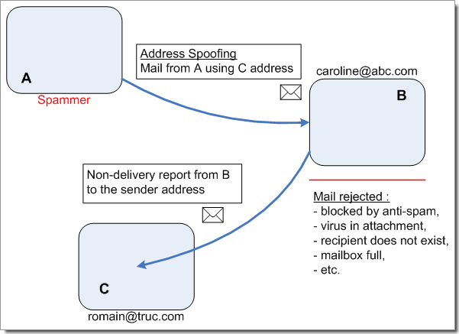
4. Email spoofing
A spoofed email is one that appears to originate from one source but actually has been sent from another source.
Notes:
Example: Mr. X has an e-mail address mrx@domain.org. Mr. Y spoofs his e-mail and sends obscene messages to all his acquaintances. Since the e-mails appear to have originated from Mr. X, his friends could take offence and relationships could be spoiled for life.

Slide 15
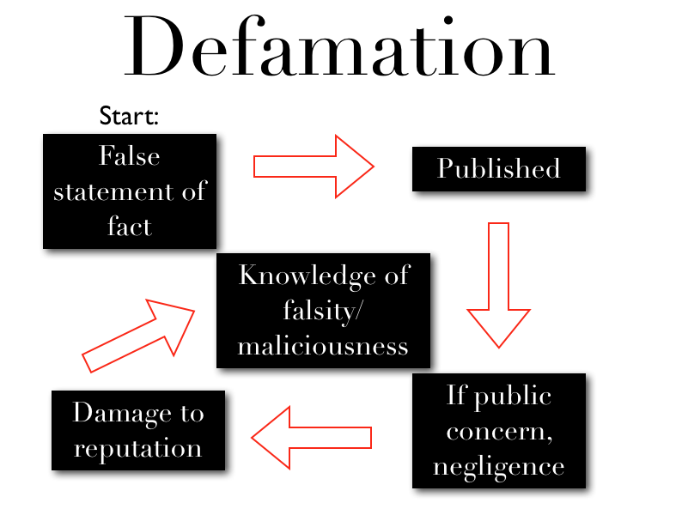
5. Cyber Defamation
This occurs when defamation takes place with the help of computers and / or the Internet.
Example: Someone publishes defamatory matter about someone on a website or sends e-mails containing defamatory information to all of that person's contacts.

Slide 16

6. Cyber stalking
Cyber stalking involves following a person's movements across the Internet by posting messages (sometimes threatening) on the bulletin boards frequented by the victim, entering the chat-rooms frequented by the victim, constantly
bombarding the victim with emails etc.

Slide 17
Classification of Cyber Crimes
Where computers become target of crime
This category includes computer oriented cyber crimes.
Some types are:
Unauthorized Access(Hacking)
Malicious Software(Viruses, Trojans- corrupts server)
Worm (Self-replicating programs)
Spyware – parasitic software, invades privacy,
Divulging details through tracking cookies.
Cyber terrorism

Slide 18
A. Unauthorized Access
Also known as Hacking.
Involves gaining access illegally to a computer system or network and in some cases making unauthorized use of this access.
Hacking is also the act by which other forms of cyber-crime (e.g., fraud, terrorism) are committed.

Slide 19
A. Theft of information
Theft of any information contained in electronic form such as that stored in computer hard disks, removal storage media, etc.
Can extend to identity theft.

Slide 20
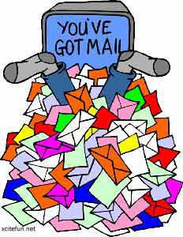
A. Email Bombing
This refers to sending large number of emails to the victim resulting in the victim's email account (in case of an individual) or mail servers (in case of a company or an email service provider) crashing.

Slide 21
A. Salami Attacks
These attacks are often used in committing financial crime and are based on the idea that an alteration, so insignificant, would go completely unnoticed in a single case.
E.g. a bank employee inserts a program, into the bank's servers, that deducts a small amount of money (say 5 cents a month) from the account of every customer. This unauthorized debt is likely to go unnoticed by an account holder.

Slide 22
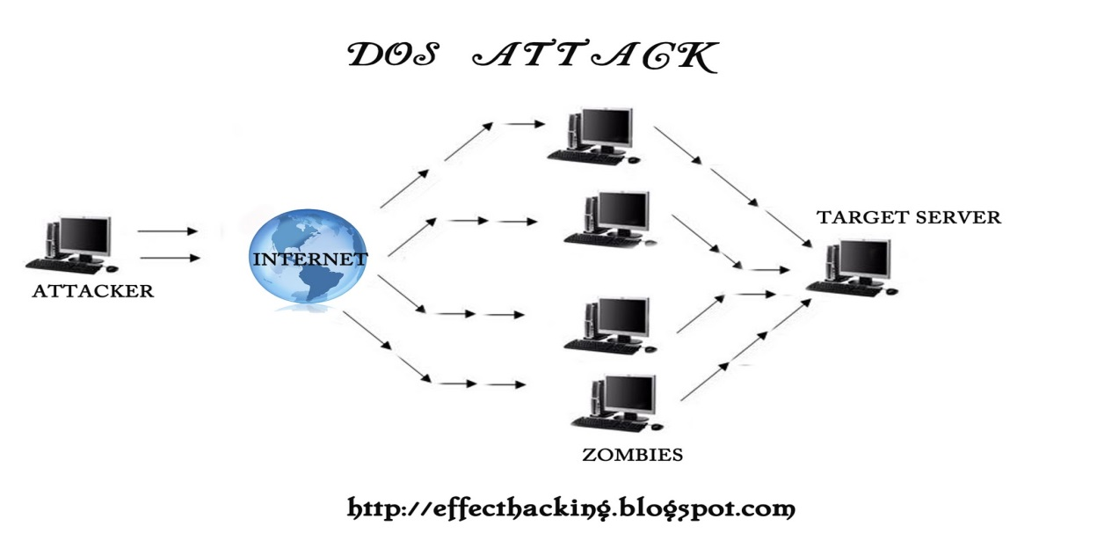
A. Denial of Service (DoS) Attack
This involves flooding a computer resource with more requests than it can handle, causing the resource (e.g. a web server) to crash thereby denying authorized users the service offered by the resource.

Slide 23

B. Virus
Viruses are programs that attach themselves to a computer or a file and then circulate themselves to other files and to other computers on a network. They usually affect the data on a computer, either by altering or deleting it.

Slide 24
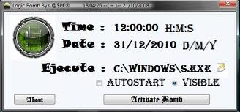
B. Logic Bombs
These are event dependent programs where programs kick into action only when a certain event (known as a trigger event) occurs.
Some viruses may be termed logic bombs because they lie dormant throughout the year and become active only on a particular date (e.g. Chernobyl virus).

Slide 25
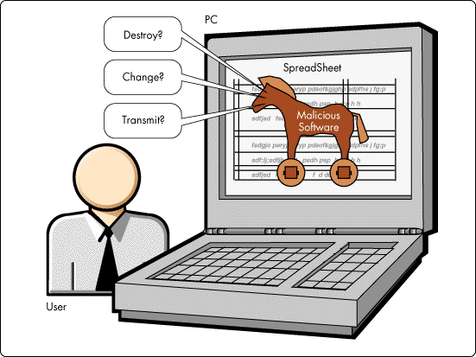
B. Trojan Attacks
An unauthorized program which functions from inside what seems to be an authorized program, thereby concealing what it is actually doing.

Slide 26
C. Worm
Worms, unlike viruses do not need the host to attach themselves to. They merely make functional copies of themselves and do this repeatedly till they eat up all the available space on a computer's memory.

Slide 27
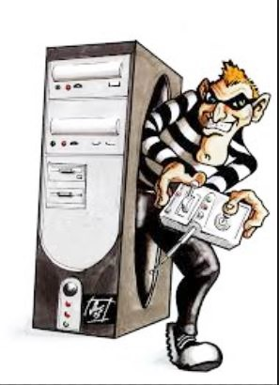
D. Web Jacking
This occurs when someone forcefully takes control of a website (by cracking the password and later changing it).

Slide 28
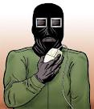
E. Cyber-Terrorism
Hacking designed to cause terror. Like conventional terrorism, `e-terrorism' utilizes hacking to cause violence against persons or property, or at least cause enough harm to generate fear.

Slide 29
Computer Security
Computer security (also known as cyber security or IT security) is information security as applied to computing devices such as computers and smartphones, as well as computer networks such as private and public networks, including the Internet as a whole.
Computer Security is the protection of computing systems and the data that they store or access.

Slide 30
Computer Security
Computer Security covers all the processes and mechanisms by which computer-based equipment, information and services are protected from unintended or unauthorized access, change or destruction.
Computer security also includes protection from unplanned events and natural disasters.

Slide 31

Why is Computer Security Important?
Enabling people to carry out their jobs, education, and research.
Supporting critical business process.
Protecting personal and sensitive information.

Slide 32
Why do I need to learn about Computer Security?
Good Security Standards follow the "90 / 10" Rule:
10% of security safeguards are technical.
90% of security safeguards rely on the computer user ("YOU") to adhere to good computing practices
Example: The lock on the door is the 10%. You remembering to lock the lock, checking to see if the door is closed, ensuring others do not prop the door open, keeping control of the keys, etc. is the 90%. You need both parts for effective security.

Slide 33
What Does This Mean for Me?
This means that everyone who uses a computer needs to understand how to keep their computer and data secure.
Information Technology Security is everyone's responsibility

Slide 34
Simple measures to be followed…
Many cyber security threats are largely avoidable. Some key steps that everyone can take include:
Use good, cryptic passwords that can't be easily guessed and keep your passwords secret
Make sure your operating system and applications are protected with all necessary security patches and updates
Make sure your computer is protected with up-to-date antivirus and anti-spyware software

Slide 35
Simple measures to be followed…
Don't click on unknown or unsolicited links or attachments, and don't download unknown files or programs onto your computer
Remember that information and passwords sent via standard, unencrypted wireless are especially easy for hackers to intercept
To help reduce the risk, look for https in the URL and the little padlock that appears in the URL bar or in a corner of the browser window before you enter any sensitive information or a password.
Also avoid standard, unencrypted e-mail and unencrypted Instant Messaging (IM) if you are concerned about privacy

Slide 36
What are the consequences for security violations?
Risk to security and integrity of personal or confidential information
e.g. identity theft, data corruption or destruction, unavailability of critical information in an emergency, etc.
Loss of valuable business information
Loss of employee and public trust, embarrassment, bad publicity, media coverage, news reports
Costly reporting requirements in the case of a compromise of certain types of personal, financial and health information
Internal disciplinary action(s) up to and including termination of employment, as well as possible penalties, prosecution and the potential for sanctions / lawsuits

Slide 37
Summary
Definition of Cyber Crime
Classification of Cyber crimes
Computer Intrusions and Hacking
Computer Security

